Slide 1
Lesson 2

Slide 2
Recap
So far, we have modified the pages that participants view with html, JavaScript etc. and managed what to show to participants and which pages participants can access with python.
Next, we define key characteristics of the experiment and ultimately define the shape of the dataset:
How many rounds, how many participants per group?
What variables as an experimenter to collect?
At what level are the variables shared/defined/accessable?

Slide 3
Models.py
Defines some basic constants such as number of rounds, number of players in a group etc.
Defines the shape of your datasets: what variables and whether those are for the group or the player
Further defines if these variables are text or numbers, limited to some range etc.

Slide 4
Look through the models.py file of lesson1
Where to store stuff? Depends! Not always just one option.
Constants are executed only ones - no changing variables!
Subsession variables can be also randomly variables that are fixed for the subsession (but not necessarily round) and shared by all players. F. ex. “state of the world” – more on Day 2.
Group variables are easily accessible by everybody in the group
Being concise is good – do not add the same variable everywhere

Slide 5
Tasks for models.py
…workshop\lesson2\models.py
oTree is quite sensitive to mistakes in the models.py – don’t be discouraged if your code does not run – compare with a neighbour!

Slide 6
Alternative coding solutions
The contribution decision could have been modelled as a player decision.
To calculate the payoffs, we could have made a group variable ”contributions”
To calculate the total ”contributions”, add on the wait page, after all players arrive:
for player in self.group.get_players()
  self.group.contributions = self.group.contributions + player.contribution
Then, trigger an alternative set_payoffs function under the Player instance
set_payoffs(self):
  self.payoff = Constants.endowment – self.contribution + 2*self.group.contibutions

Slide 7
Classes have objects
oTree hides a lot of underlying python coding in the core files and then ”herits” from this core
Child objects herit from parents
For example, each of the pages inherits from the oTree parent Page
Any heritable object can be overwritten with the child
Advanced (Warning! Do not edit anything in the core files!) By clicking the blue o-sign in Pycharm you can see the parent class that you are overwriting. Most of this information is also safely available by searching through oTree documentation online.

Slide 8
You can create your own class to herit from
For example, if you have multiple pages of instructions that all have the same features, you can create a class
Class InstructionPage(Page)
  def is_displayed(self):
    if self.round_number == 1:
      return True
Class InstructionPage1(InstructionPage)
  Pass
Class InstructionPage2(InstructionPage)
  Pass

Slide 9
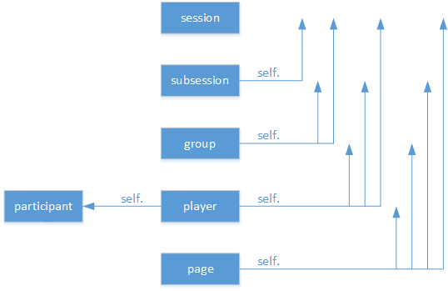
What is ’self’? Self-reference, like ”me” or ”my object”

Slide 10
What’s the difference between participant and player?
Each player has only one participant
Participant can have many players
Participant corresponds to the actual user or the ”experiment participant”, it does not change in a session
Player is application=subsession specific instance, changes from application to another
”Session” code and variables is run when you start a session from the oTree menu
”Subsession” code is run in the beginning of each app (hence subsession code can depend on previous subsession)

